Slide 2
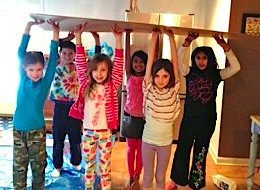
Welcome to Coach Training #2:
Competition Edition
What happens on the Big Day
Paperwork & what to bring to the BD
The Final Dress Rehearsal
The Final weeks before the BD!

Slide 3
Welcome to Coach Training #2:
Competition Edition
What happens on the Big Day
Paperwork & what to bring to the BD
The Final Dress Rehearsal
The Final weeks before the BD!

Slide 4
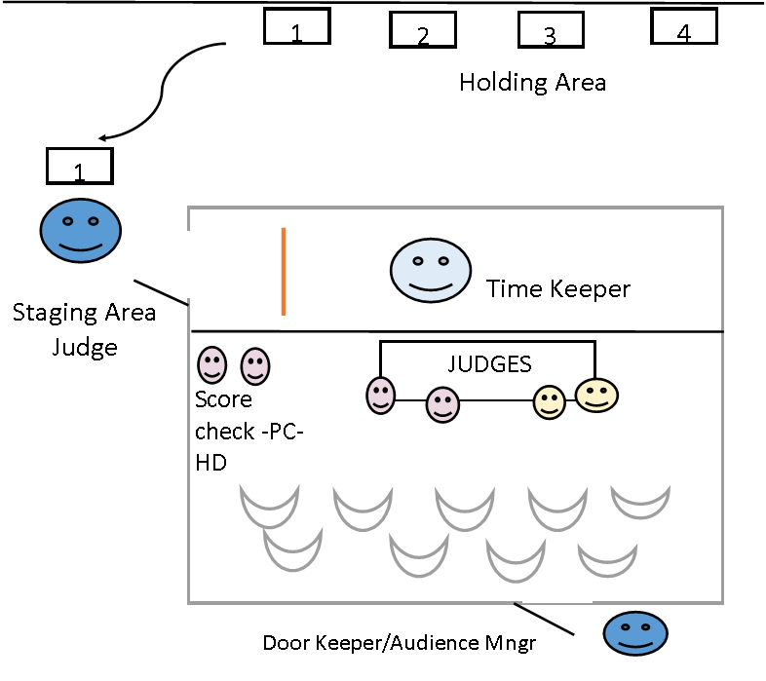

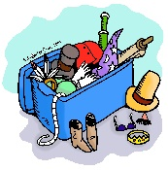


Competition Day Logistics
Let’s break this down!
School A
School B
Team, are you ready?
THE LINE!!
P1 D2/3
Drop Off
LT & Style
Spontaneous 2nd floor
Coach seats
H
X
X
C
Audience

Slide 5
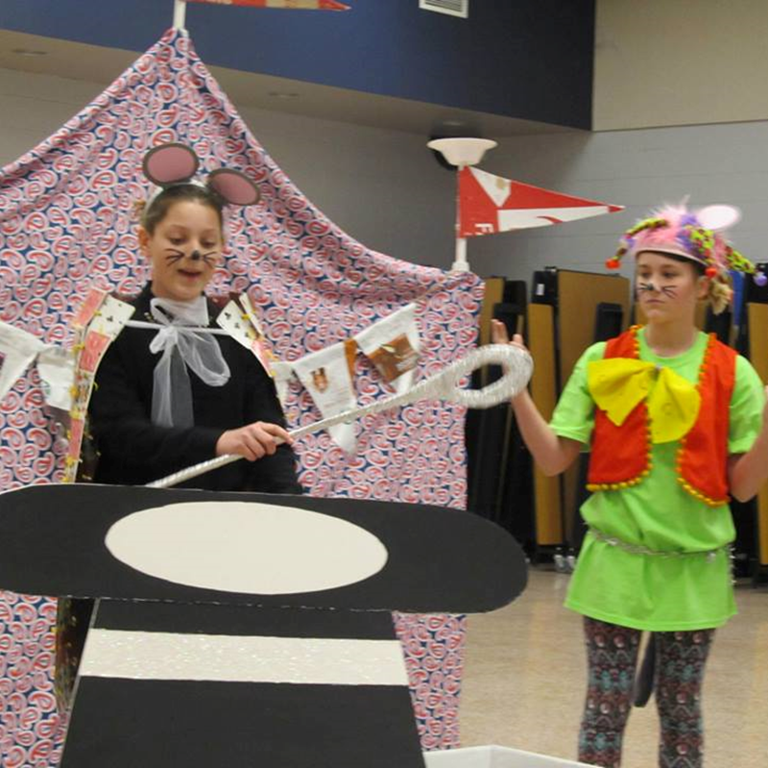
You will get a schedule for your team. It will include:
A time to perform Long Term
  15 minutes before your time, go to Staging Area Judge
  Yes, there’s an audience
A time to compete Spontaneous
  15 minutes before your time, arrive upstairs at Spontaneous check-in
  The Spont upstairs hallway is for coaches and team ONLY
  No audience during spont
  For example, you LT time may be 11:00 and your Spont time may be 1:15

Slide 6
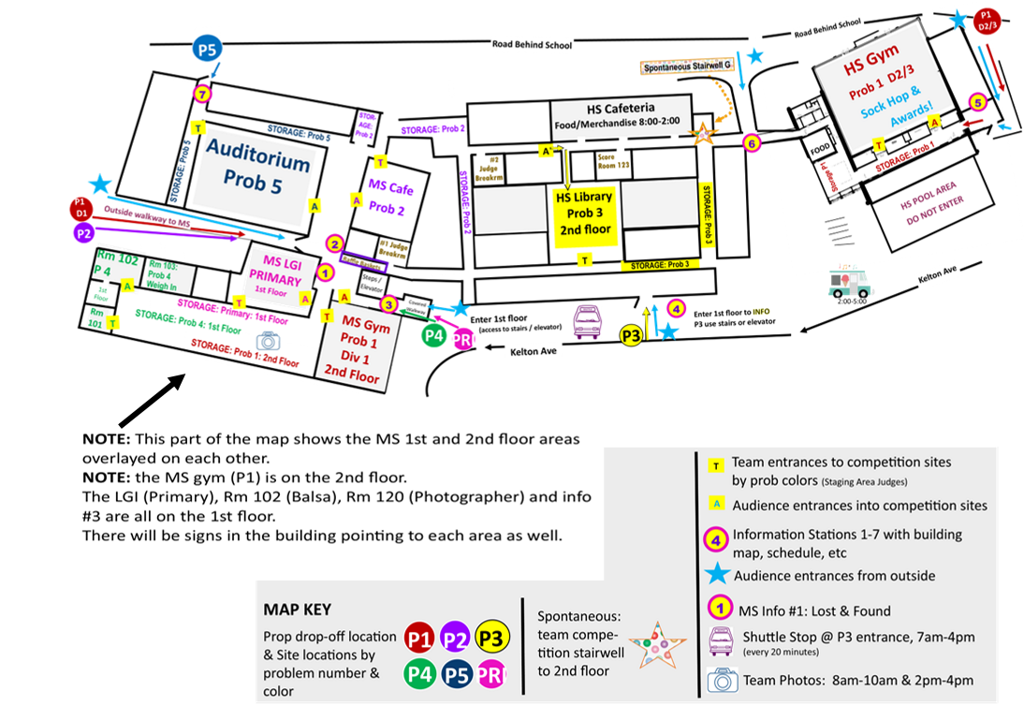
2023

Slide 7

Competition Day Logistics
Let’s break this down!
Find the Prop Drop Off Entrance for your problem.
They are color coded.
There is overflow parking for large trucks.
P1 D2/3
Drop Off
Primary – Pink
P1 – Red
P2 – Purple
P3 – Yellow
P4 – Green
P5 – Blue
Spont - Multi

Slide 8
Competition Day Logistics
Let’s break this down!
School A
School B
P1 D2/3
Drop Off
Make your way to the Holding Area.
Find the sign making the space for your team.
This is where you take your props, etc.
Parents can help get props here, but not help fix or set up anything.
LT & Style
Coach seats
X
X
Audience

Slide 9
Competition Day Logistics
Let’s break this down!
School A
School B
P1 D2/3
Drop Off
15 minutes before your competition time, make your way to the Staging Area Judge. This is often a different entrance than the audience entrance. Parents can help move items to the Staging Area.
Here, the team turns in and goes over paperwork. Coach should be in the background. Parents should be in the competition site waiting to cheer on their team!
LT & Style
Coach seats
X
X
Audience

Slide 10
Competition Day Logistics
Let’s break this down!
School A
School B
THE LINE!!
P1 D2/3
Drop Off
When the team is done with the SA Judge, they can move their props to THE LINE.
Parent may help move props here. But no further!
Here the team waits and from here the team will begin their 8 minutes of competition.
LT & Style
Coach seats
X
X
Audience

Slide 11
Competition Day Logistics
Let’s break this down!
School A
School B
Team, are you ready?
THE LINE!!
P1 D2/3
Drop Off
LT & Style
Time Keeper: MC, times performance
Style & LT judges: know who is who
Reserved seats for coaches
When the door closes, it can’t be opened.
Coach seats
X
X
Audience

Slide 12
Competition Day Logistics
Let’s break this down!
School A
School B
Team, are you ready?
THE LINE!!
P1 D2/3
Drop Off
When the team is done (TIME!!!) the judges will come up on stage to talk with them about their solution.
When judges are done, parents may help the team move their stuff & clean the site.
Props go to your car or back to the holding area
LT & Style
Coach seats
X
X
Audience

Slide 13
  For example, you LT time may be 11:00 and your Spont time may be 2:15
  Things to do in between:
  Eat
  Get in the “zone”
  Unwind outside or watch other problems
  Not recommended to give kids back to their parents unless they are really young

Slide 14
Competition Day Logistics
Let’s break this down!
School A
School B
Team, are you ready?
Spontaneous is on the second floor.
There is no audience for spont.
The team and coach check in. They go to a holding area.
When it’s their turn, the coach and team split up –and meet after the team is done.
P1 D2/3
Drop Off
LT & Style
Spontaneous 2nd floor
Coach seats
H
X
X
C
Audience

Slide 15












2. Spontaneous Holding areas – classrooms
2nd Floor
Typical Spontaneous Competition Site
The nuts and bolts
1. Spontaneous Check-in Coach and team only
2. Spontaneous Holding Areas Classrooms where teams and coaches are taken to wait until their time to compete.
3. Teams walk to the competition site with a Spontaneous judge.
4. Competition Room Teams go in without their coach and compete for the Spontaneous judges.
5. After they compete, teams are walked to a pickup spot to meet their coach.
4. Spontaneous Competition rooms - classrooms
3. Heading to compete
Spontaneous Check-in
5. Spontaneous Meeting Area
1. Arrive at Spont. Check-in

Slide 16
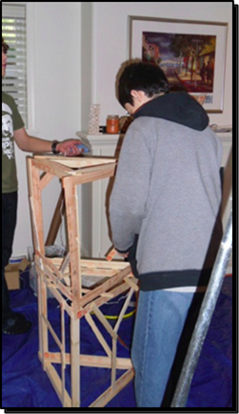
What to do when you're not competing
Prepare for your LT
Get in the ‘zone’ for spontaneous
Watch other teams
Clean up your holding area
Eat lunch
Buy souvenirs
Buy raffle tickets
Sock Hop starts at 4:00 in the HS Gym!
Awards Ceremony starts around 6:00.

Slide 17
Paperwork
In competition, each team must provide the following items for its long-term solution.
The team members must fill out all of their forms on their own with the exception of Division I and Primary, where the coach may write for the team but the team members must dictate what is to be written. Teams should keep an extra copy of all their forms. Most of the following items will be examined and/or collected by the Staging Area Judge:
  Four completed copies of the Style Form.
  Four completed copies of the Team List Form (if required in the problem).
  One completed Cost Form.
  One completed Outside Assistance Form.
  One membership sign (must include team name and membership #, visible 25 ft away)
  Problem clarifications specific to the team’s solution.
  All props, costumes, etc. necessary to complete the problem solution, except those listed in the problem under “Tournament Director Will Provide.”
  Any items listed in the problem under “Team Must Provide”

Slide 18
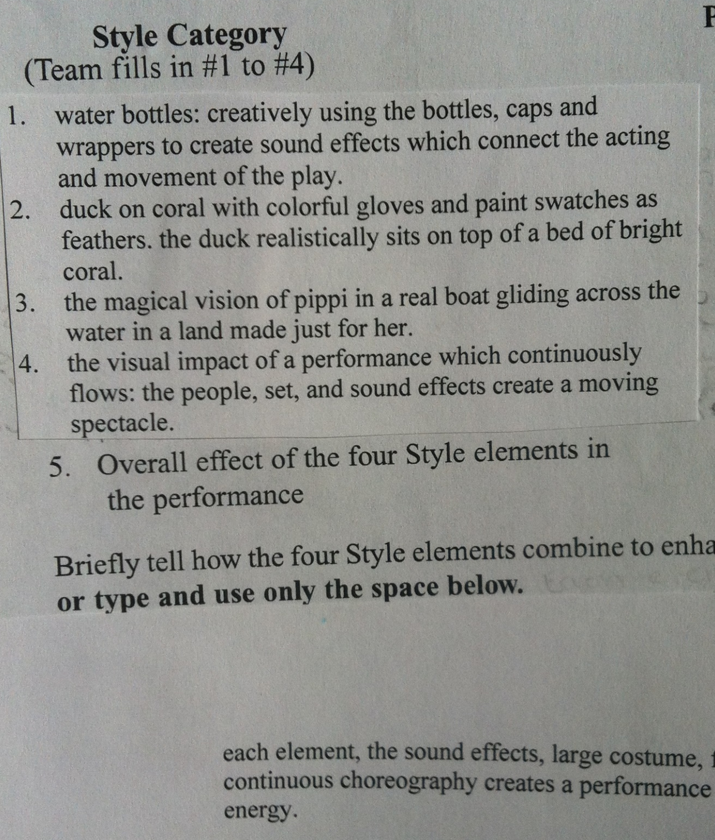
Style Form, including Free Choice items
• Style’s not an afterthought! Fight for all 50 points. #5 in Style means your 4 other style elements have to be meaningful in the performance, not just cool. Fight for those 10 points! Carefully consider the wording of your 2 free choice elements and exactly what you are telling the judges to observe. Fight for those 20 points! Know exactly what the other 2 style elements are looking for and do that. Fight for those 20 points! Put yourself in the shoes of the judge walking up to check out your Style. Ask yourself: Am I intrigued? Do I have to ask follow up questions to fully understand what you did? Does it look different/surprising up close than it did from the audience? If you’re not answering YES to these questions, then you’re not giving your style judges enough to look at.

Slide 19
Style Form, including Free Choice items
If the team hasn’t determined what Free Choice elements to use, they can review the long-term problem solution and identify and list items or part of items that are not scored in the problem.
The team should review the list and select items that it believes are the most creative.
Be explicit about what the team wants to be scored (i.e., the construction of a costume or the use of materials, rather than the costume itself).
Identify the items to be scored so the judge can find them easily. (Not “Joe’s costume” but “Construction of the clown’s costume”).
Make sure the team prepares the Style Form (Program Guide Appendix). Style Judges use the synopsis on the team’s Style Form as a guide when scoring the team. It is essential that the team writes its synopsis clearly and expresses ideas succinctly!
List on the style form specifically what you want the judge to score.
Brag a little. Let them know, in a few words, why you nailed the style item.

Slide 20
Cost Form
The Cost Limit for each problem is listed on the problem
The cost form includes the value of the materials used on stage
This includes the value of all items, including rented, loaned and borrowed items. See Program Guide for specifics.
Make sure the team fills out the Material Values Form (Program Guide Appendix). Detailed rules for completing the Materials Value Form are in the Program Guide, where you’ll also find a list of items that are exempt from cost.
It’s a good tip to make sure you don’t spend your full value in case the team missed something.
Forms can be arranged by prop or by material: Everything used in the boat. Everything that duct tape was used in.

Slide 21
Outside Assistance Form
Print out 1 Outside Assistance Form.
The team should report and OA on this form.
If there isn’t any, write NONE.
All team members and the coach should sign the form.
Bring 1 copy to the competition.
Check Program Guide for specifics, such as use of AI

Slide 22
Team List form
Keep it simple. This form is used to quickly help the judges know what they are looking for.

Slide 23
Places to get the info you need
Link to Members Area on international site to print out paperwork form: Team List, Style Form, Outside Assistance Form, Cost Form.
WPA Tournament details: schedule, volunteer schedule, menu, raffles, maps, parking, logistics, etc.
Link to see the Program Guide which details how to fill out the forms, how to assess cost to certain items, general rule, etc.
Link to the Clarifications so you know what applies to your problem. And print out any that you may have gotten separately in an email.

Slide 24
The Final Dress Rehearsals
Make sure the performance is under 8 minutes including set up.
When practicing, have the team start in a “staging area” before proceeding to the competition area.
All parts of a problem solution must fit through a standard doorway.
Vary the setup so the team is prepared to compete on a site that may be arranged differently than they expect. Enter from different sides of the stage.
The team members need to consider what they will do if one of them cannot attend a competition for some reason. Keep in mind that this may happen unexpectedly.
Encourage the team to make lists:
  In what order do we bring things on stage
  What needs to happen before we go on – put a prop together, make sure the prop is set up, etc.
Videotaping a practice and letting the team members critique it is an excellent way to get them to improve their presentation in-school. Don’t tell them to be louder (OA), let them critique each other.
Teams should discuss and practice what they’ll do if something breaks or does not work. They can bring a “fix it” bag which contains paint sticks, duct tape, hammer etc.
Teams should know whether it is better to continue with their solution and receive penalty points, rather than stop to fix something, since the points scored by continuing may offset the penalty points incurred for having something not work correctly.

Slide 25
Tournament Day Tips
On tournament day the coach needs to spend time with the team, and not on fixing last-minute problems. Enlist help from the parents.
Make sure the parents know the location of the competition site and the team’s performance schedule.
Make a check list of things that the team needs: Props, Repair kit (In an easily identifiable bag or box), Forms, including clarifications, Snacks & Activities to keep them occupied.
Get parents to take care of transporting the props. Provide instructions on where and when to meet the team.
Visit the problem site with the team early to become familiar with the layout of the site and the location of entrances, exits, and the Staging Area, outlets. The team needs to make any changes to their plan caused by the site setup well before their performance time.
The team needs to unpack and check all props in the Holding Area.
Get to the long-term competition site at least 15 minutes early.
Have parents assigned to take care of props after the competition- bring a dust broom/pan or something to clean up stray performance items.
Get to the spontaneous site early enough so the team members can have some quiet time before they enter.

Slide 26
Understanding Your Scores
Long-Term Scoring
The team earning the highest score for each long-term problem and division in a competition is awarded 200 points unless the problem states otherwise. Every other team receives a percentage of 200 based on its raw score in relation to the highest raw score. Any penalty points are deducted after scores are calculated. No team will receive a score below zero for its long-term score. There are two types of scoring categories for the long-term problems:
(1) Subjective scoring categories are generally based on creativity, quality, effectiveness, humor, and other areas that are qualitative and an opinion of the judge. These are scored on a sliding scale, such as 1 to 15 points.
(2) Objective scoring categories are based on whether or not the team completes certain requirements of the problem. These scores are absolute, such as 0 or 5 points. An example of objective scoring is, “The vehicle crosses the Finish Line.”

Slide 27
Awards Ceremony
There is a break between the final performance and the awards ceremony. This is a good time to:
Clean up prop storage area and pack your team’s stuff back into your vehicles.
Get a bite to eat- can go to a local place depending upon how early you finished, or, it is nice and convenient to support the Moon groups selling concessions.
Buy auction tickets to support our Odyssey of the Mind program- costs to host the regional event are increasing.
Enjoy the DJ and slide show in the gym- let the kids dance on gym floor while parents can relax and chat in the bleachers.
Remind your team to give everyone the courtesy of their attention and applause during the ceremony- whether it is a speaker or a team being recognized.
Do not leave until the last award has been given- every person/team deserves the same respect regardless of what order they received recognition.

Slide 28
Advancers Meeting
After the Awards Ceremony there is a brief meeting for teams that are advancing to the State Competition. It is very important for a coach to attend this meeting as information will be disseminated which will need a quick turn around time for some responses. You will be informed how many Judges your school needs to provide & other important details.

Slide 29
Judge Final Tips
Be on time
If judging LT, read the problem before the judge training & bring a copy to the tournament.
Be familiar with the clarifications and bring them to the tournament.
Have a positive attitude - even though you may not get what the kids are doing, try to put yourself in their place and recognize how much effort they have made.
Be careful in conversations around teams, in hallways, etc. Negative comments are harmful on many levels
Some teams may have similar themes or solutions - treat each time you see something as if it is the first time you did. This can happen more frequently with spontaneous. If you scored it as creative the first time, it needs to be scored as creative additional times you hear the response.
Post it notes should be positive - share any concerns with your PC or head judge to address
Introduce yourself to the other judges – you are part of the same team!
Welcome and help relax the team members.
Congratulate every team for solving the problem.
Take notes to remember each solution.
Consider the entire range when scoring subjective categories.
Have Fun!

Slide 30

Stay in Touch
Angela & Susan: RegionalDirector.W@PAOdyssey.com
Western PA Odyssey of the Mind: https://www.wpaodyssey.org/
WPA Facebook: https://www.facebook.com/WPAOM
International Odyssey of the Mind (HQ): Odysseyofthemind.com
PA Odyssey of the Mind: PAOdyssey.com

Slide 31
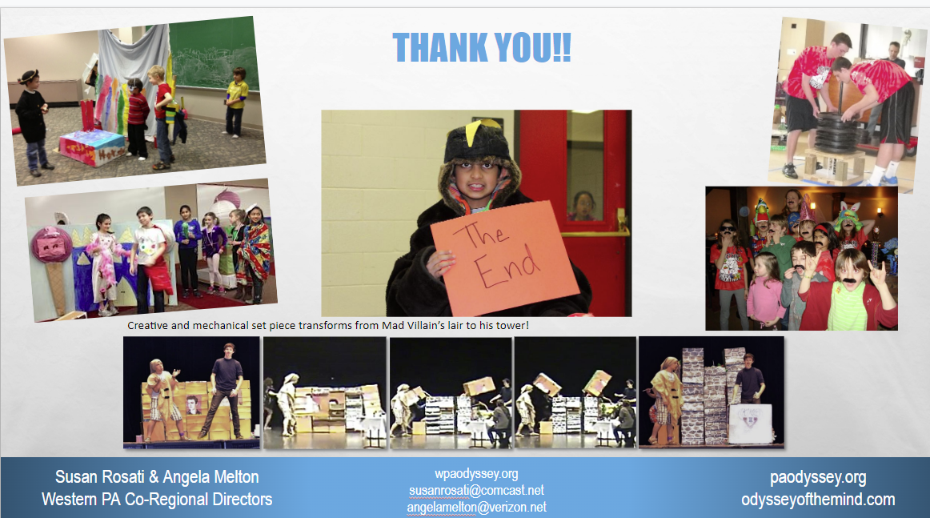

Slide 32
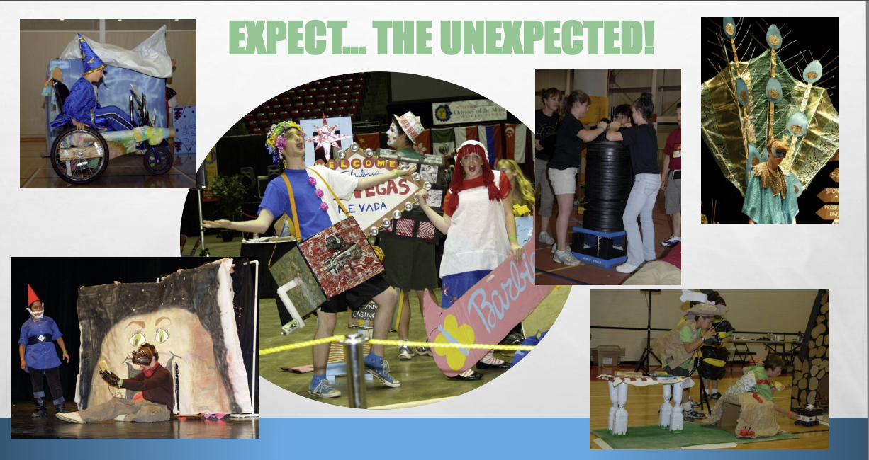
Don’t have preconceived notions of how the problems should be solved!

Slide 33
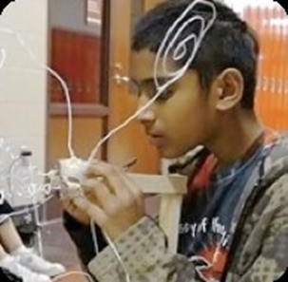
What you might see at an Odyssey of the Mind Competition….
(keep scrolling)

Slide 34
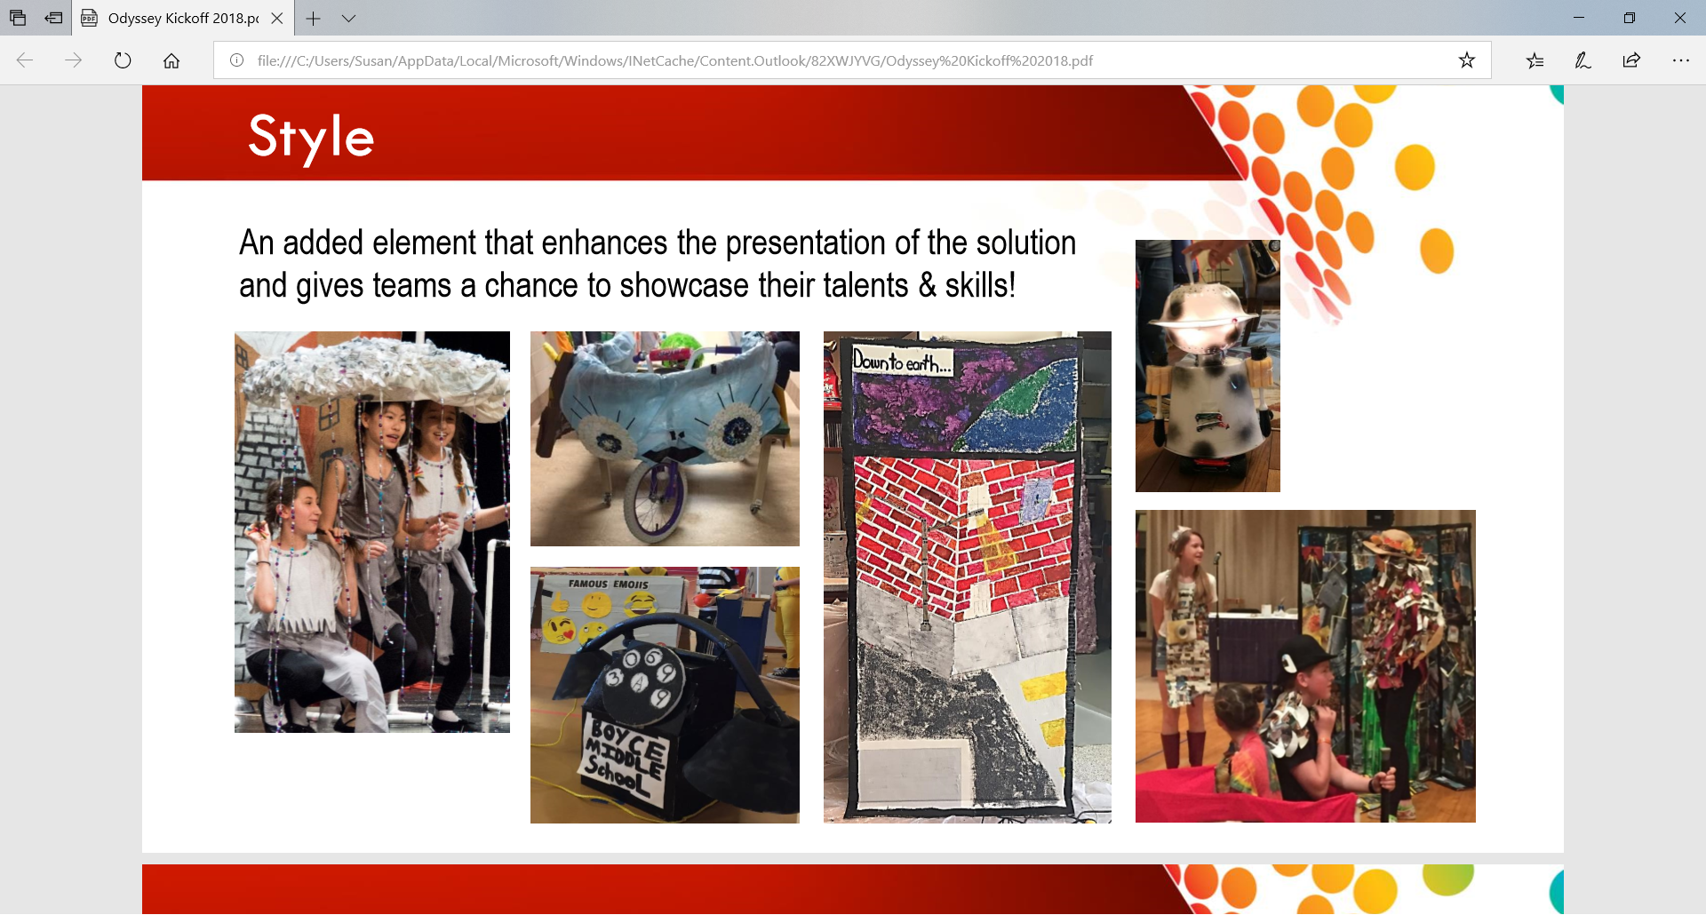
Style Elements
Added scored elements that enhance the solution – a chance to showcase talents and skills.

Slide 35
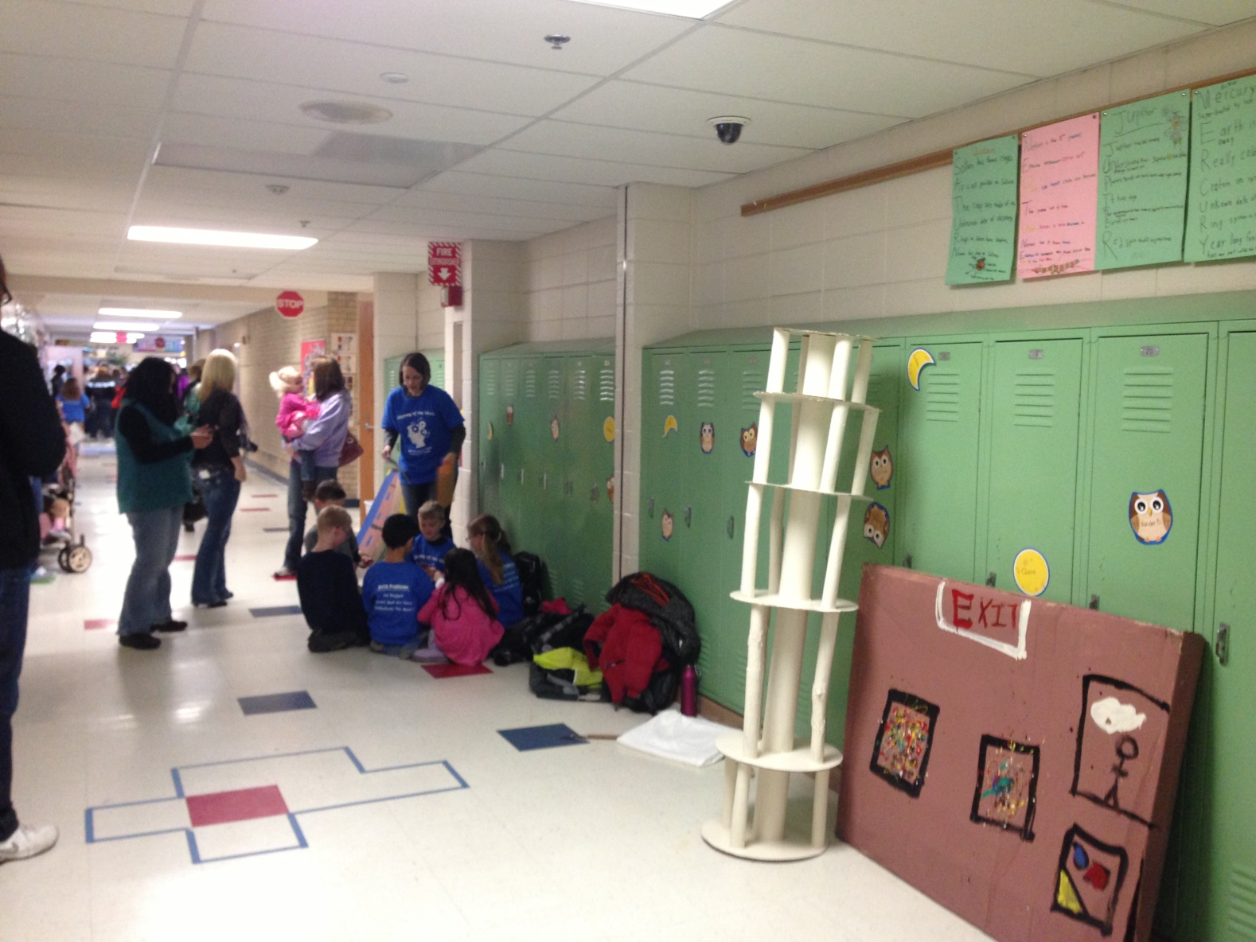

Slide 36
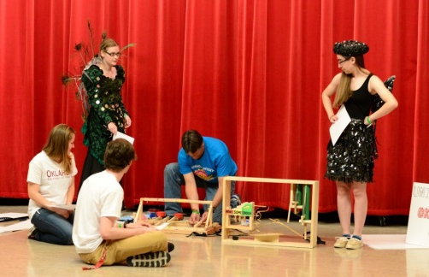

Slide 37
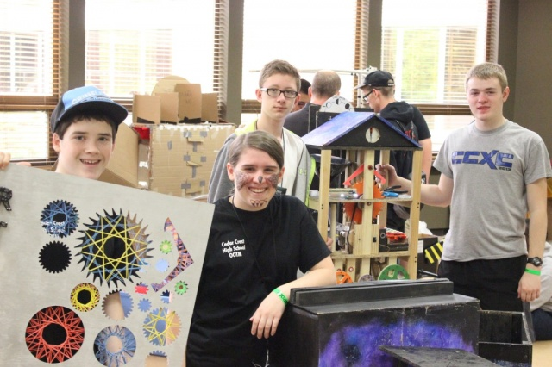

Slide 38
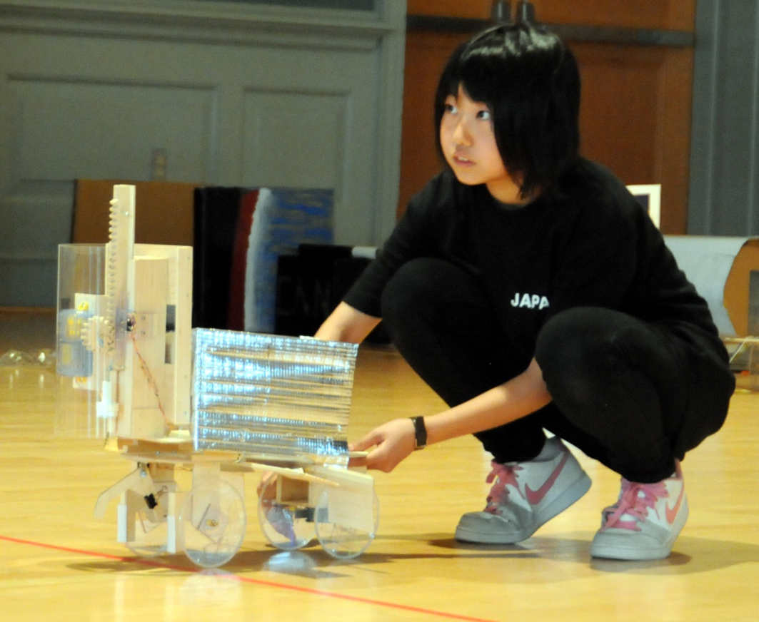

Slide 39
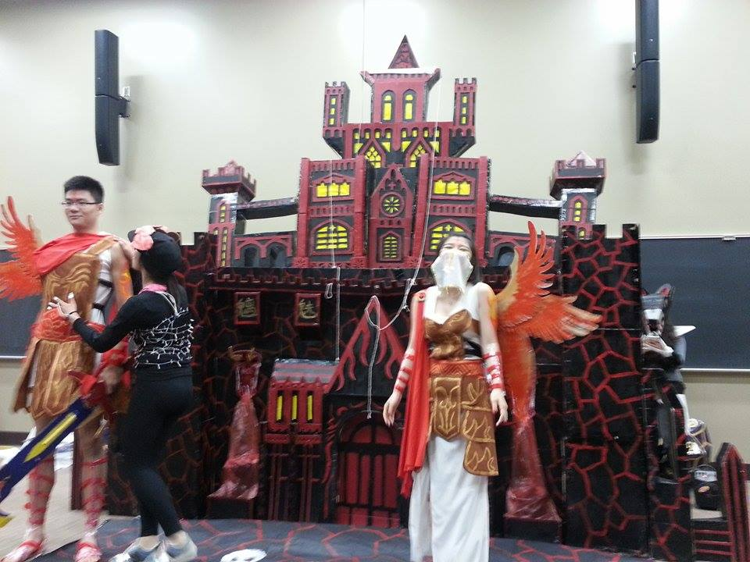

Slide 40
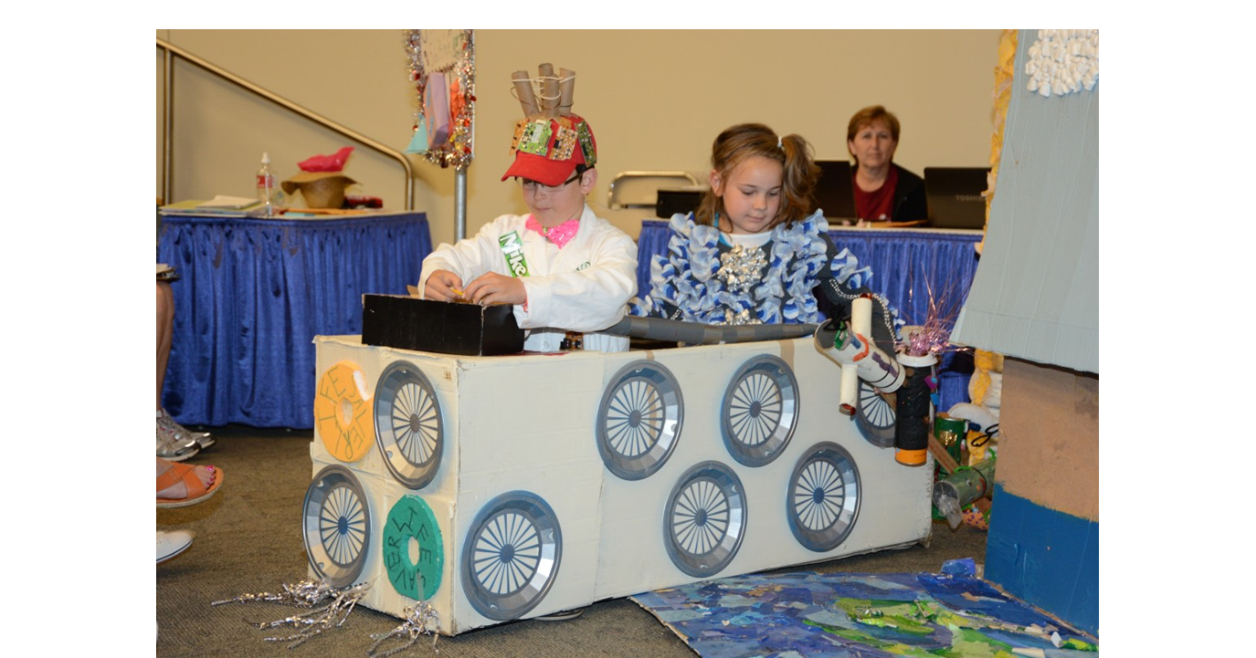

Slide 41
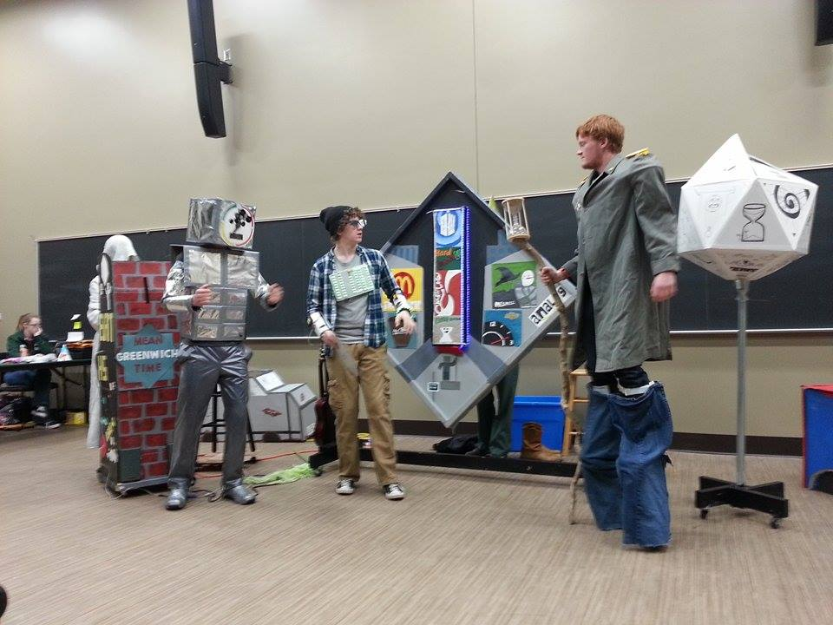

Slide 42
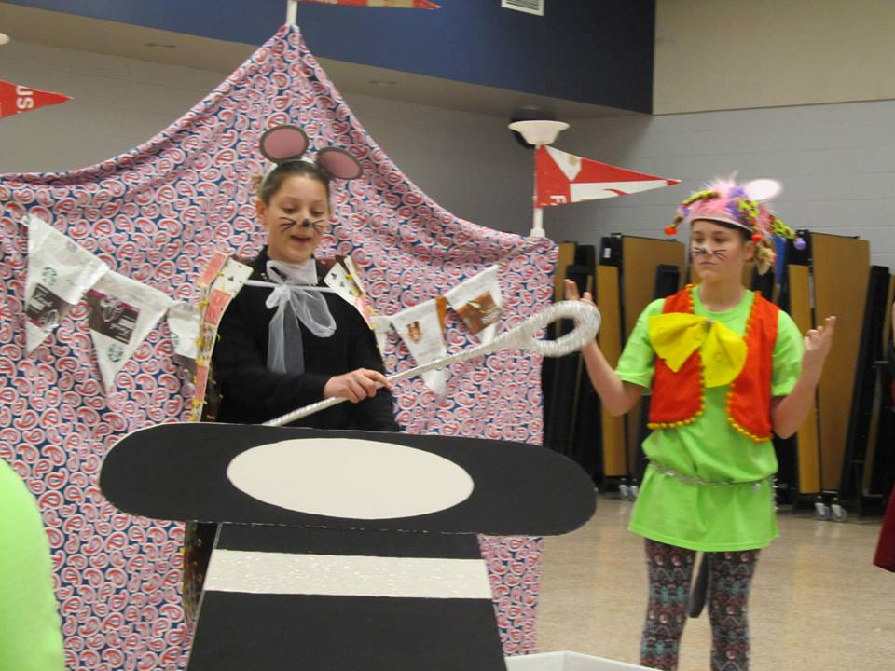

Slide 43
